Slide 1
ASSIGNMENT 1 : ROV
ROBOTIC HARDWARE (MCTE 4362)
Lecturer:
Dr. Zulkifli bin Zainal Abidin
Slide by:
Muhammad Iqmal Danish bin Hasnan (1912461)

Slide 2
02
HISTORY OF ROV

Slide 3
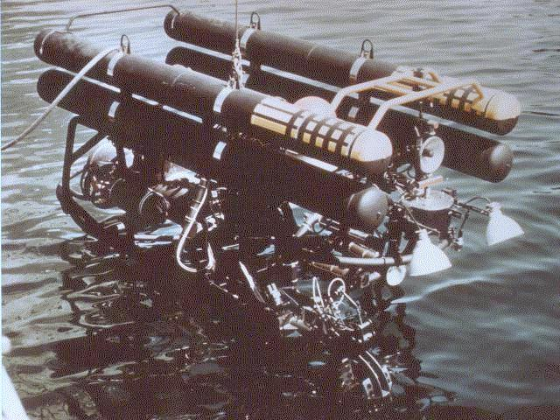
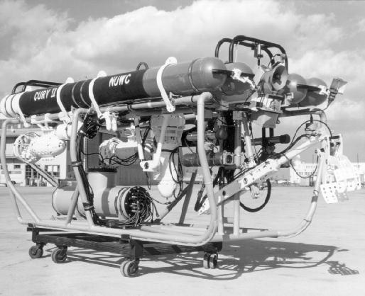
Early 1960’s by NOTS Pasadena Lab and SSC Pasific
CURV I
Cable-Controlled Undersea Recovery Vehicle (CURV)
Used by the US Navy to locate and retrieve torpedoes used in tests and training from the seafloor.
Retrieved a hydrogen bomb that had been lost in the Mediterranean Sea of Palomares, Spain.
Weighs roughly a ton and can operate depths of about 2,000 feet.
Operated by a five-man crew on the surface.
Controls it through a closed-circuit television network.
Acoustic detection and positioning components are also involved.
Upgraded later generations of CURV designated CURV II, CURV II-B, CURV II-C
CURV II

Slide 4
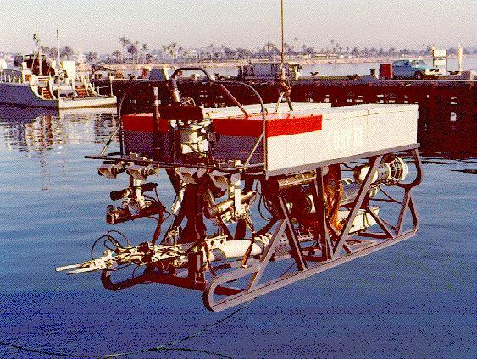
Year 1973 by NOTS Pasadena Lab and SSC Pasific
CURV III
Employed to rescue two-man crew of the submersible Pisces III, which had sunk off the coast of Ireland.
Enhanced from 10,000 to 20,000 feet of operation using technologies developed for the Remote Unmanned Work System (RUWS) and the Advanced Tethered Vehicle (ATV).

Slide 5
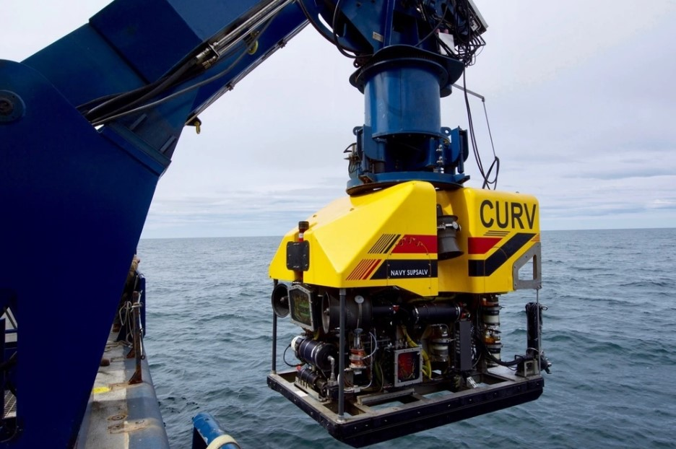
Year 2012 by US NAVSEA
CURV 21
6,400-pound Remotely Operated Vehicle (ROV).
Built to fulfil the US Navy's needs for deep ocean salvage down to a maximum depth of 20,000 feet of seawater.
The system is built around a 0.680 fiber-optic umbilical cable and a shared handling system that can switch between side-scan sonar and ROV operations while at sea.
Self-contained and flyaway transportable for global response on available platforms.
Recovered a crashed US Air Force F-16 Fighting Falcon in the North Pacific Ocean.

Slide 6
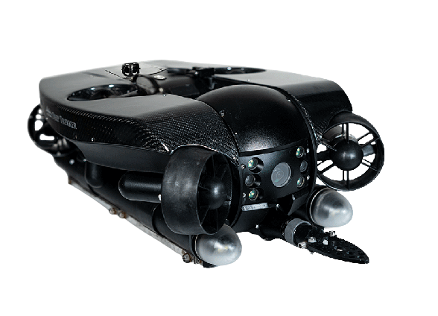
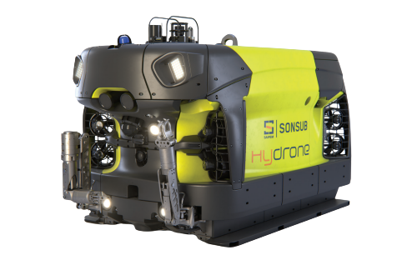
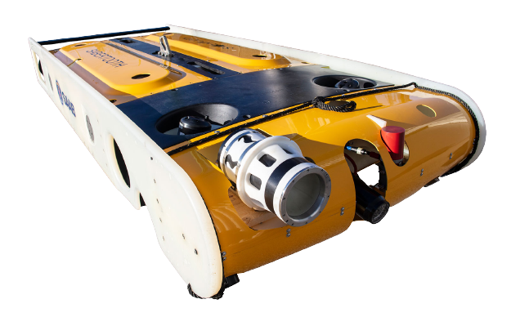
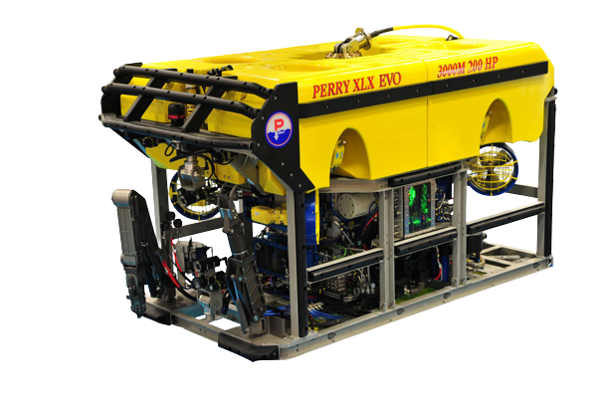
Latest Invention Up To This Day
Saab Seaeye Sabertooth
Perry XLX EVO
Deep Trekker
Revolution
Saipem's Hydrone-R
Inspection, repair, and maintenance, as well as surveying.
Advanced sensors and propulsion systems are included.
For tasks involving oil and gas exploration, building, and maintenance.
Can dive depths of up to 4,000 meters.
Advanced control systems and payload capabilities.
For search and rescue, aquaculture, and inspection.
Equipped with lighting and high-resolution cameras.
For tasks including monitoring and underwater inspection.
Advanced navigation systems and sensors.
Use a human operator or operate autonomously.

Slide 7
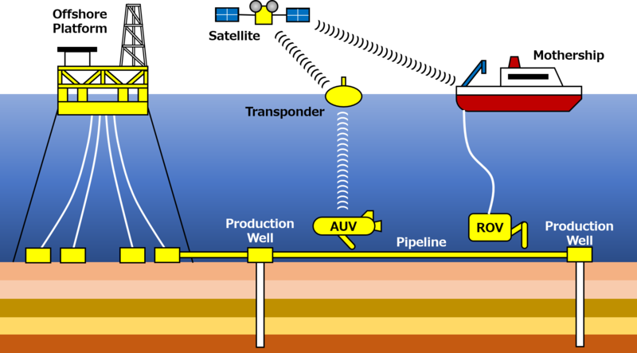
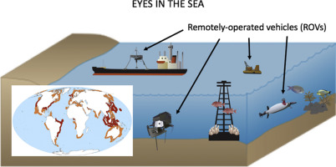
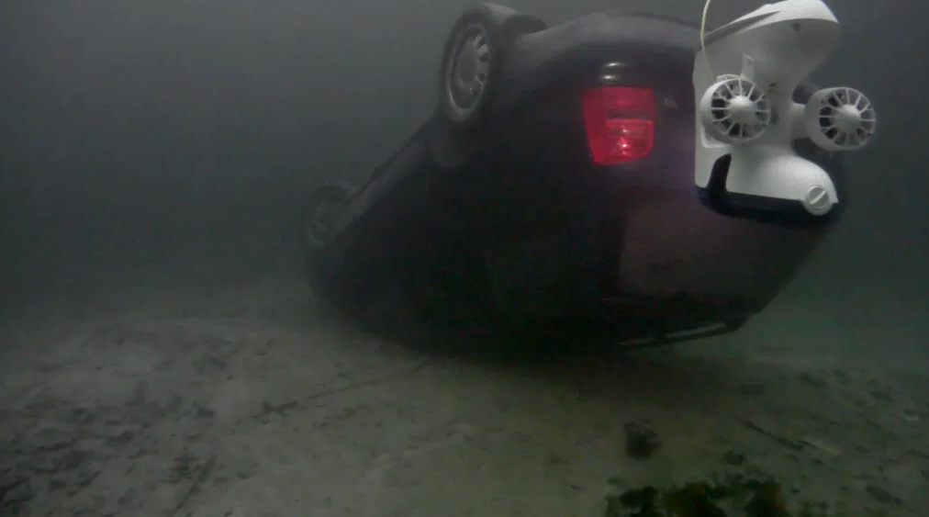
Applications
Oil & Gas Exploration
Oceanography & Marine Biology
Search & Rescue
Inspection of pipelines, underwater surveys, and monitoring of underwater infrastructure.
Subsea drilling, installation, and upkeep.
Investigate undersea ecosystems.
Gather samples.
Keep an eye on the environment.
Operation of search and rescue in both freshwater and saltwater locations.
Helpful in deep water where human divers may be unable to operate safely.

Slide 8
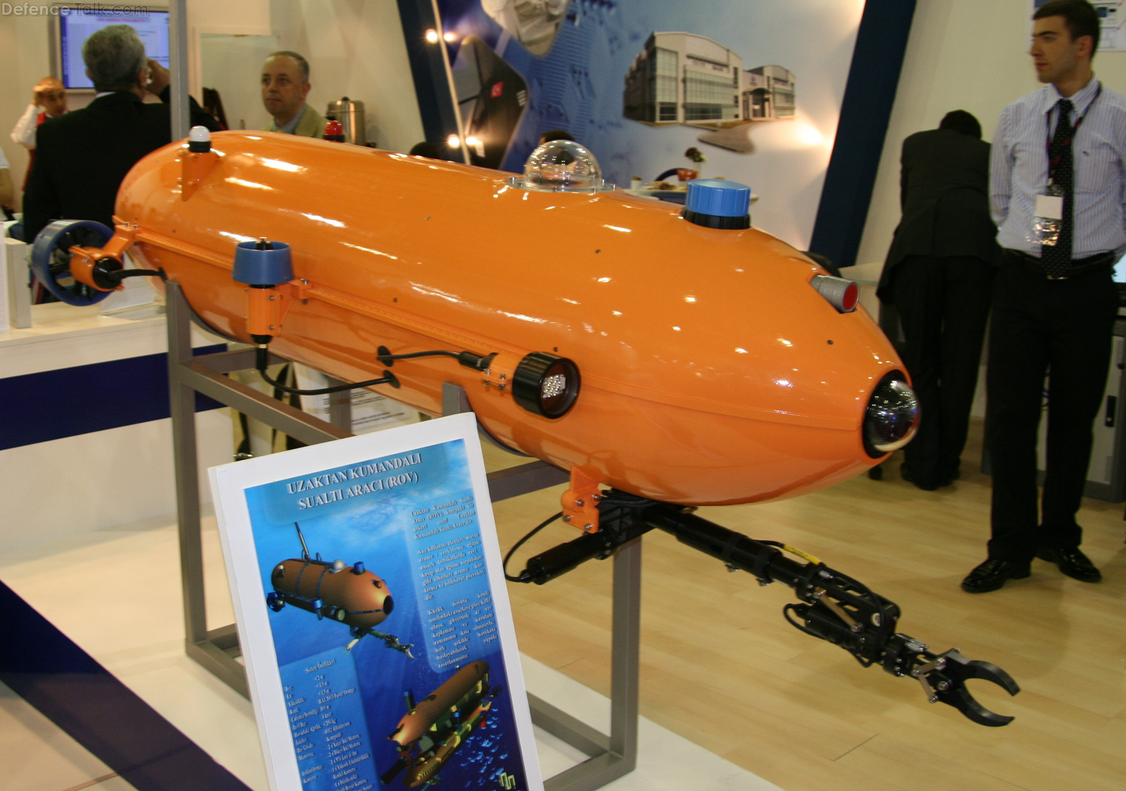
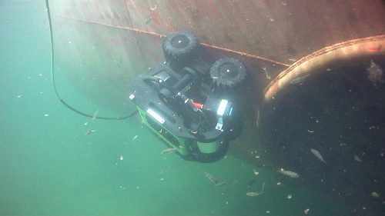
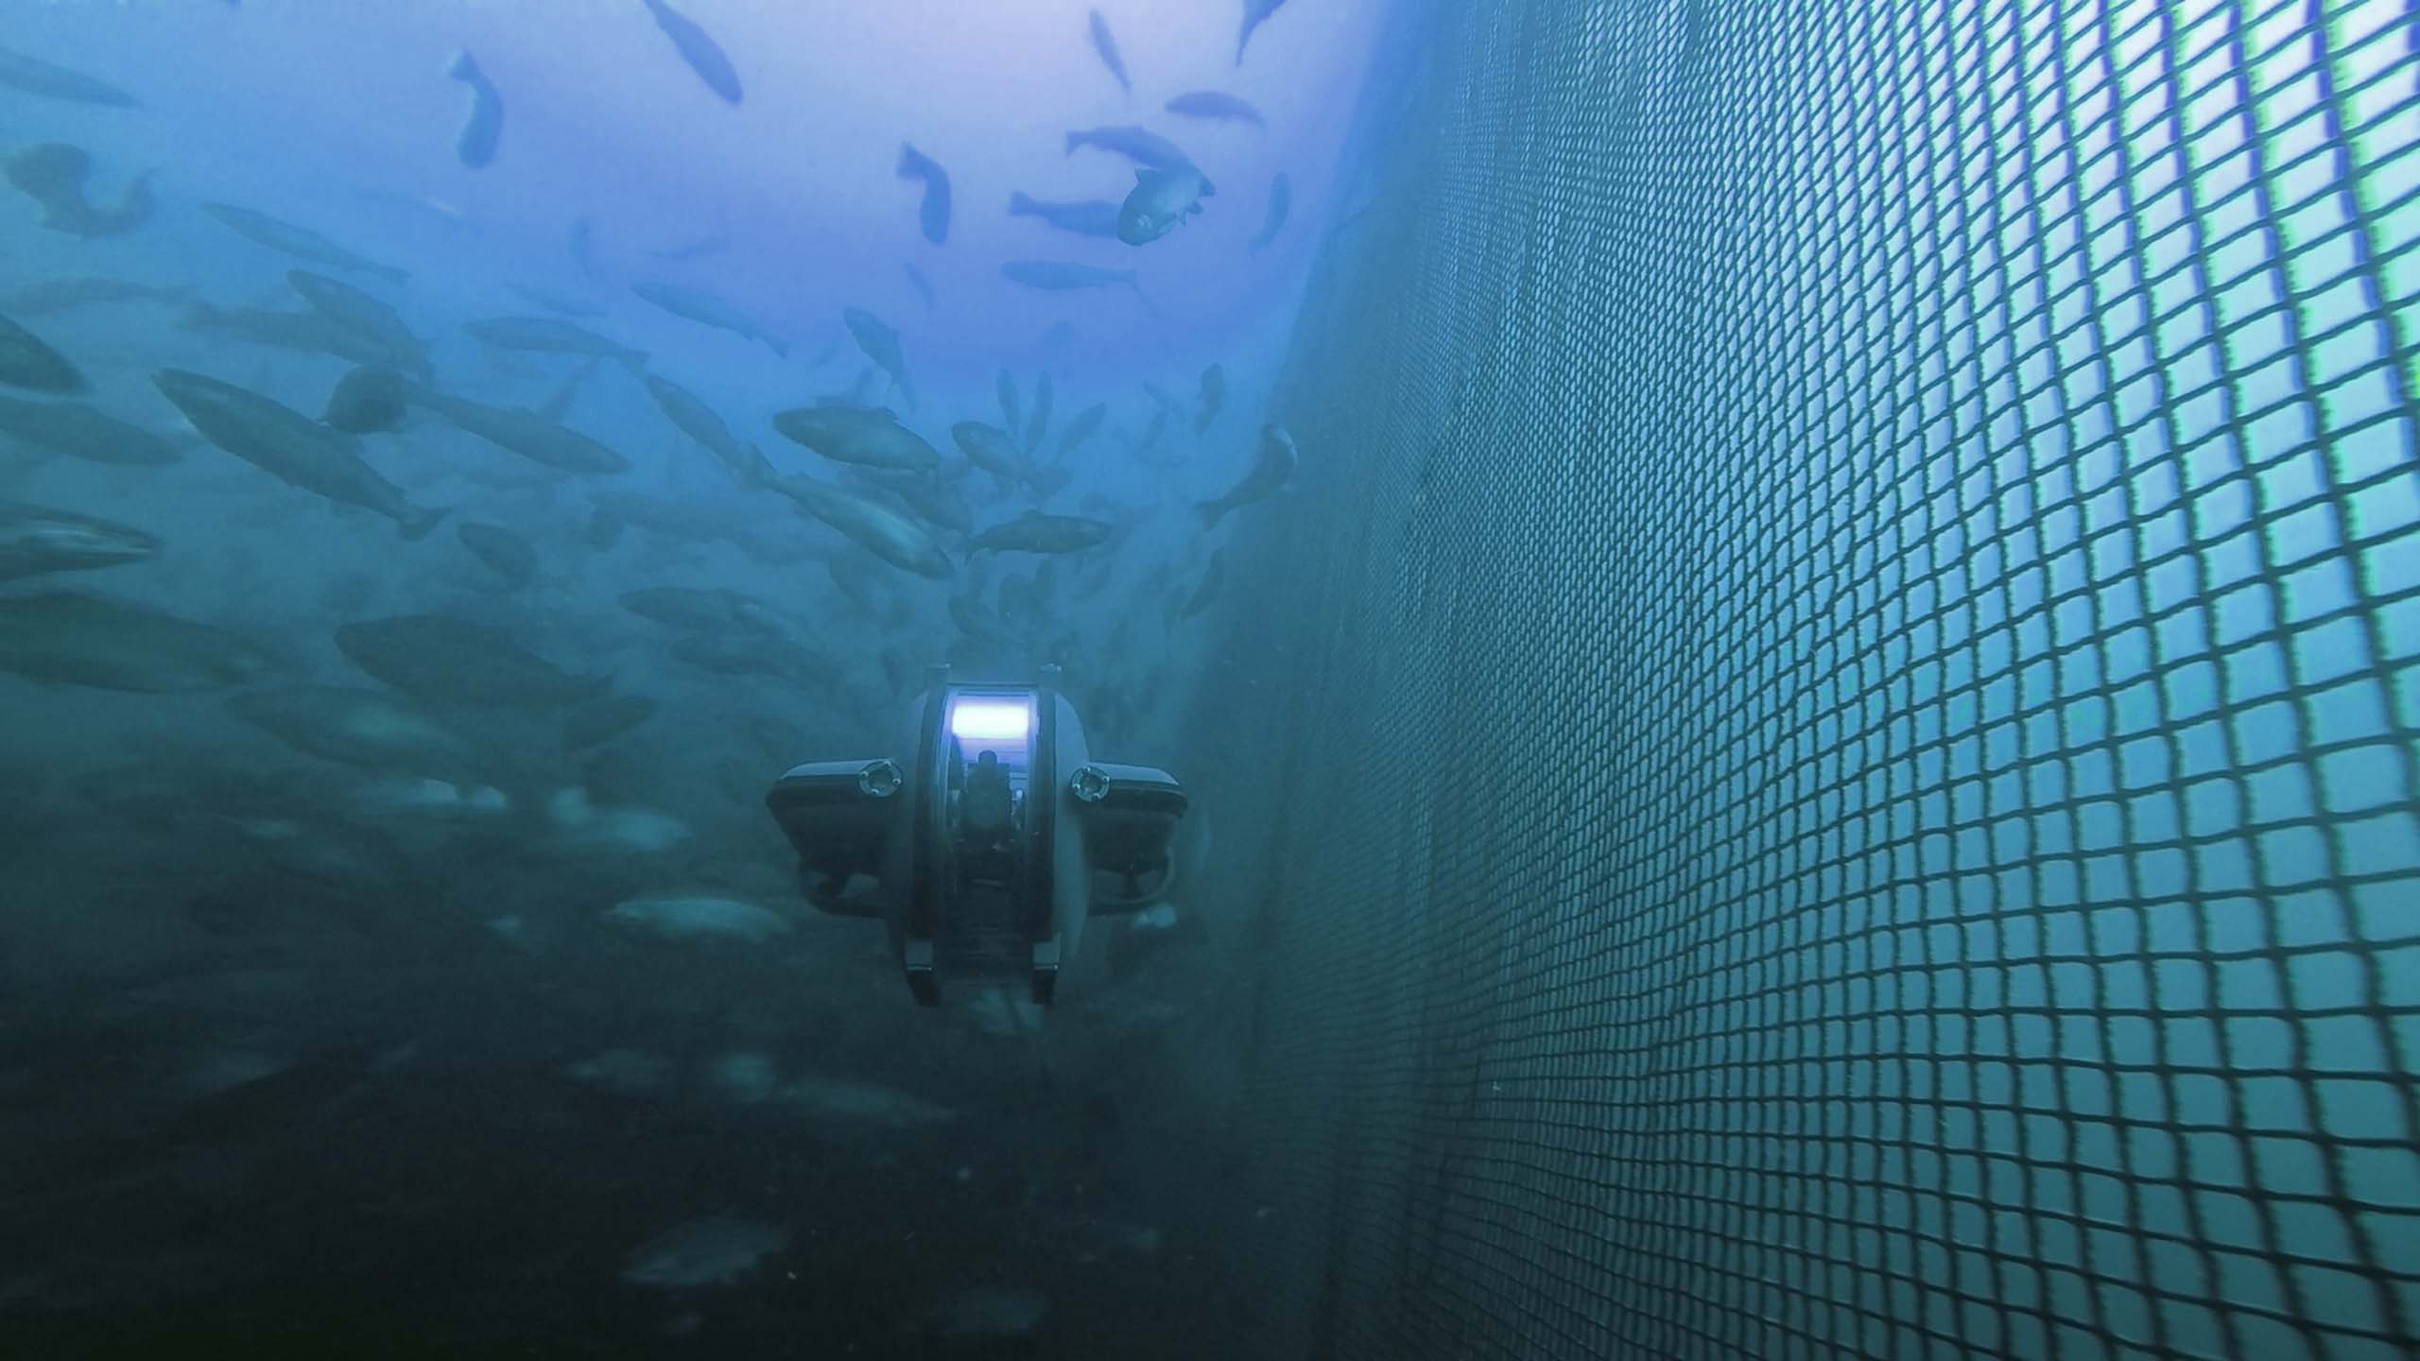
Applications
Military & Defence
Underwater Inspection & Maintenance
Aquaculture
Mine detection and removal.
Underwater surveillance.
Search and recovery missions.
Check and repair underwater structures like dams, bridges, and offshore wind turbines.
Underwater welding, cutting, and other types of maintenance.
Inspection and surveillance of fish farms.
Observe the health and behaviour of fish.

Slide 9
MAIN COMPONENTS OF THE VEHICLE
03

Slide 10
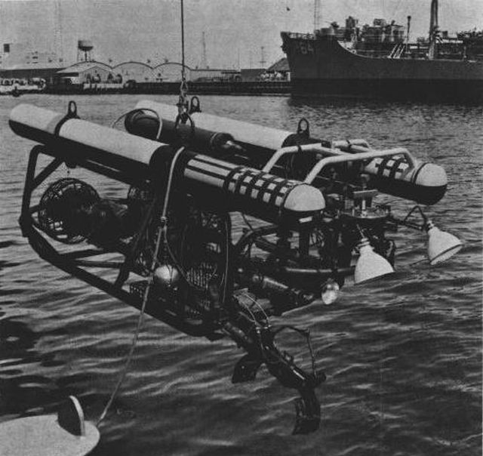
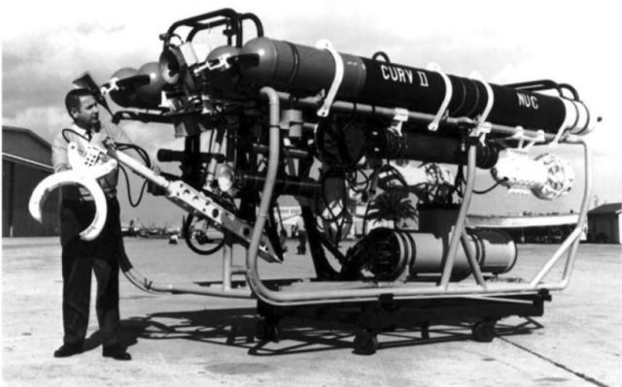
i. Hull Design
CURV I | CURV II
A cylindrical aluminium alloy hull A length of around 3 metres and a diameter of about 0.6 metres Forward section: Navigation and control systems Midsection: Power and propulsion systems Art section: recovery arm and related equipment | Superior to the initial CURV-I design More streamlined shape to reduce drag and enhance the hydrodynamic performance of the vehicle Larger in size with a length of approximately 4.3 meters and a diameter of 1.5 meters to carry more equipment Made of high-strength steel to increase its strength and durability

Slide 11
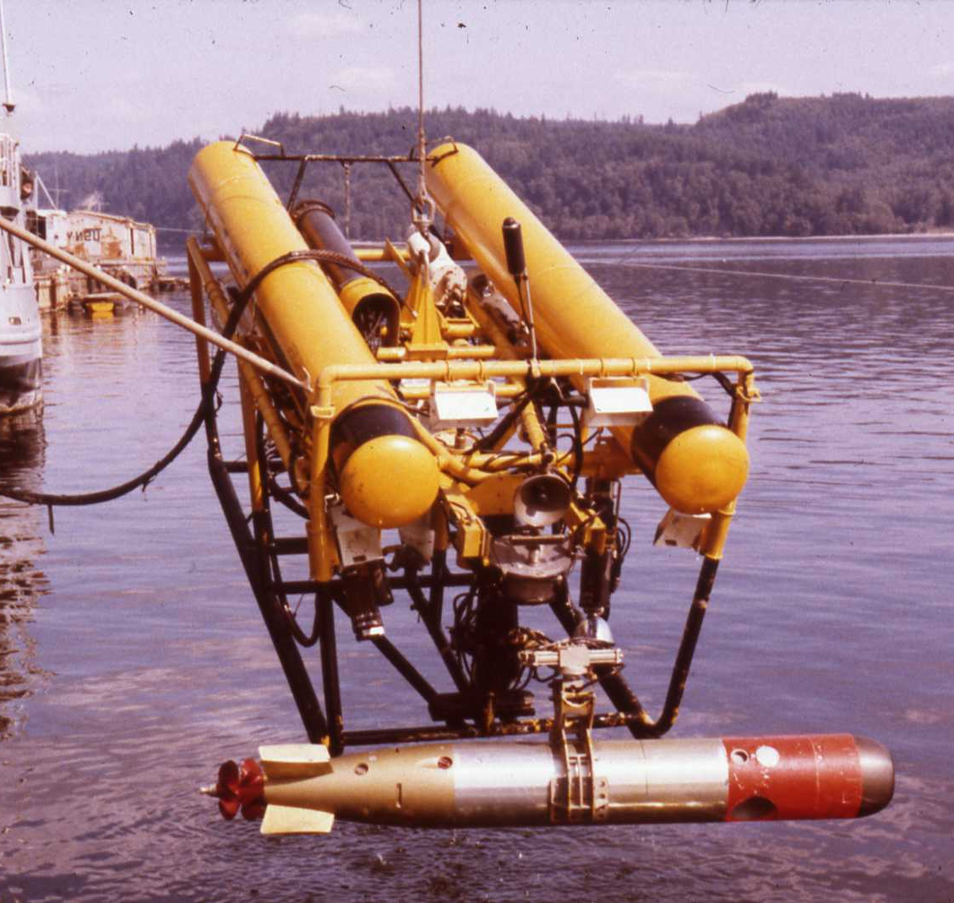
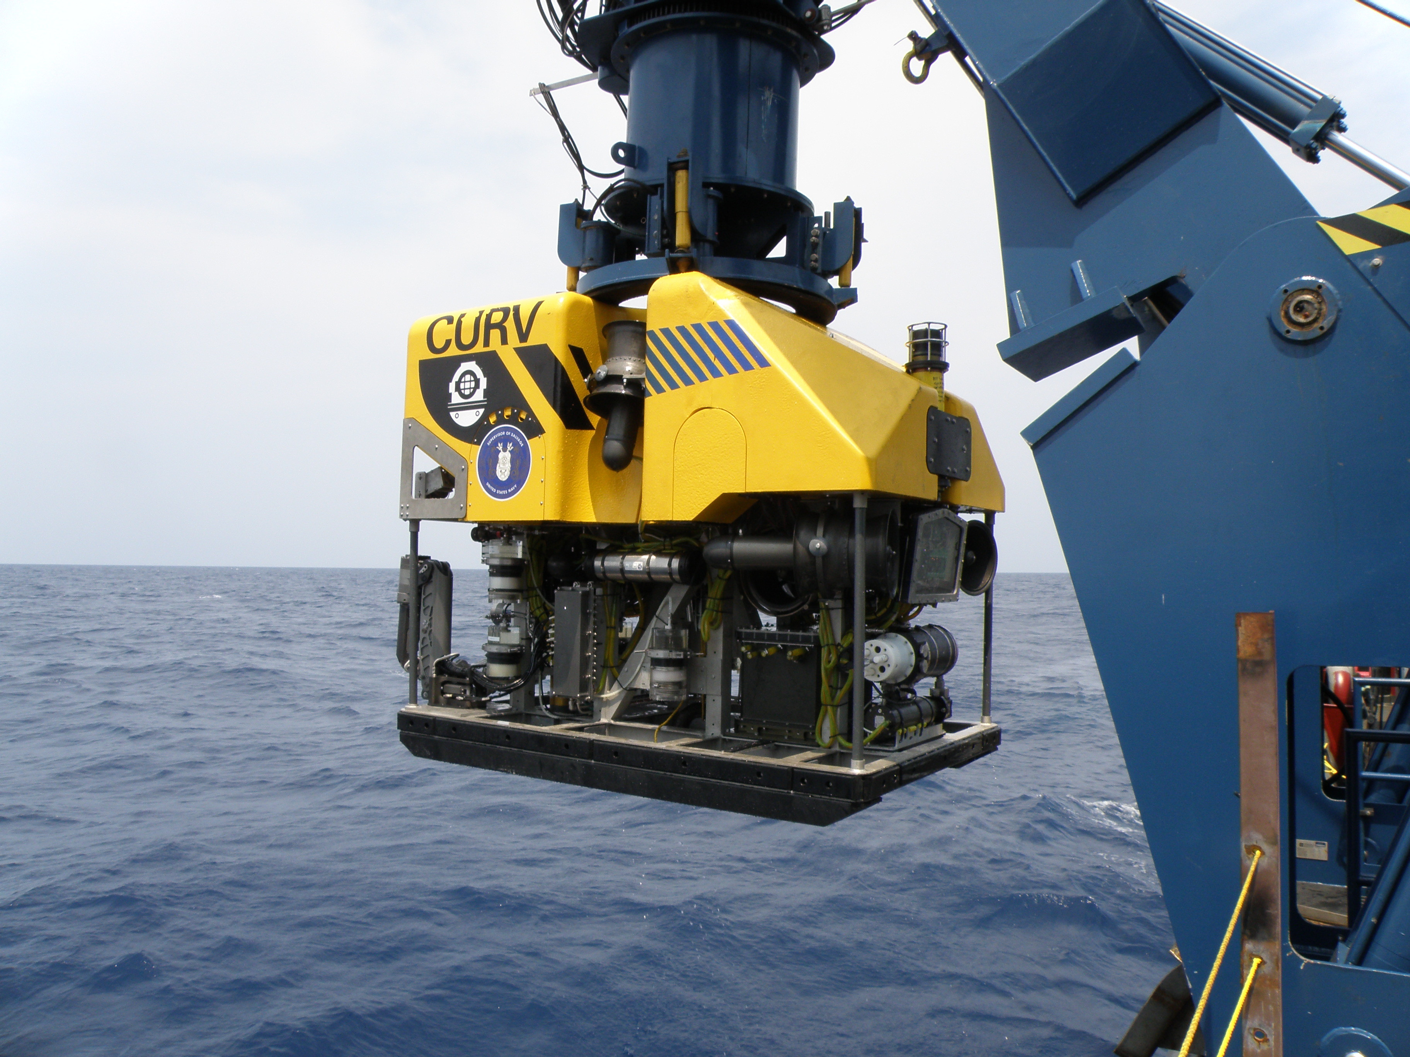
i. Hull Design
CURV III | CURV 21
Featuring a teardrop-shaped cross-section and it is more streamlined than its predecessors. Larger in size which is a length of approximately 5 meters and a diameter of 1.5 meters Made of high-strength steel rather than aluminum alloy | The cylindrical shape of CURV-21 is intended to provide optimal stability and mobility in strong ocean currents and rough sea conditions. Made of high-strength aluminum alloy Designed to carry equipment and tools for underwater search and recovery operations, such as a hydraulic cutter, grabber, and sonar systems.

Slide 12
i. Hull Design
Saab Seaeye Sabertooth | Perry XLX EVO
Built with a modular, cylindrical shape for simple customization and adaption to various mission requirements. Composed of high-strength, low-density composite materials that provide durability and buoyancy while decreasing weight. Provides for the installation of a range of sensors and instruments, such as sonar systems, manipulator arms, and sampling equipment. | The streamlined, cylindrical shape enables stability and mobility in strong ocean currents. High-strength steel and titanium alloys are used to enhance durability and corrosion resistance in hostile underwater environments. Can transport a wide range of subsea equipment and instruments, such as manipulator arms, drilling tools, and sensors.

Slide 13
i. Hull Design
Deep Trekker Revolution | Saipem's Hydrone-R
The compact, cylindrical shape enables stability and mobility in limited locations. Composed of durable, high-strength polymer materials that provide corrosion resistance and buoyancy while lowering weight. Can carry a variety of tools and equipment, including as cameras, manipulator arms, and sonar systems. | The streamlined, cylindrical hull design decreases drag and increases maneuverability in strong ocean currents. High-strength steel and titanium alloys are used to enhance durability and corrosion resistance in hostile underwater environments. Able to transport a variety of tools and equipment, such as manipulator arms, cutting tools, and inspection sensors.

Slide 14
ii. Propulsion System
CURV I | CURV II
Deep-sea mobility and stability are enhanced with a six-thruster system. Two horizontal thrusters allow for forward and reverse movement. Two vertical thrusters move up and down. Two lateral thrusters for movement to the left and right. Thrusters are reversible and electrically powered. | Four-thruster design for underwater maneuverability and control in a wide range of applications. Two horizontal thrusters allow for forward and reverse movement. Two vertical thrusters rotate upwards and downwards. Thrusters are reversible and electrically powered.

Slide 15
ii. Propulsion System
CURV III | CURV 21
Eight-thruster configuration for increased deep-sea stability and control. Four horizontal thrusters allow for movement forward, backward, left, and right. For motion up and down, there are four vertical thrusters. Thrusters are reversible and electrically powered. | Electric thrusters are used for propulsion and maneuvering. Official sources do not specify the exact number of thrusters utilized but it is believed that at least six thrusters are used for precision control. The thrusters are mounted on the frame of the ROV to enable omnidirectional movement and accurate mobility in any direction.

Slide 16
ii. Propulsion System
Saab Seaeye Sabertooth | Perry XLX EVO
It contains six vectored thrusters, each with six degrees of freedom (6 DOF). The thrusters are organized symmetrically, with two in front, two in back, and one on each side. The thrusters are brushless DC electric motors that may be controlled separately for accurate maneuvering and station-keeping. | 8 horizontal thrusters for forward, backward, left, and right movement 4 vertical thrusters for up and down movement Thrusters are brushless DC motors, with variable speed control and reversible rotation

Slide 17
ii. Propulsion System
Deep Trekker Revolution | Saipem's Hydrone-R
Six powerful thrusters. Two of which are placed vertically enabling precise vertical movement and depth retention. Four of the thrusters are horizontally positioned and vectored to allow for lateral mobility. This thruster design is ideal for holding in heavier currents and maintaining stable control when making fine adjustments during an inspection or survey. | Horizontal thrusters allow for movement forward, backward, left, and right. Vertical thrusters go up and down. Thrusters are reversible and electrically powered.

Slide 18
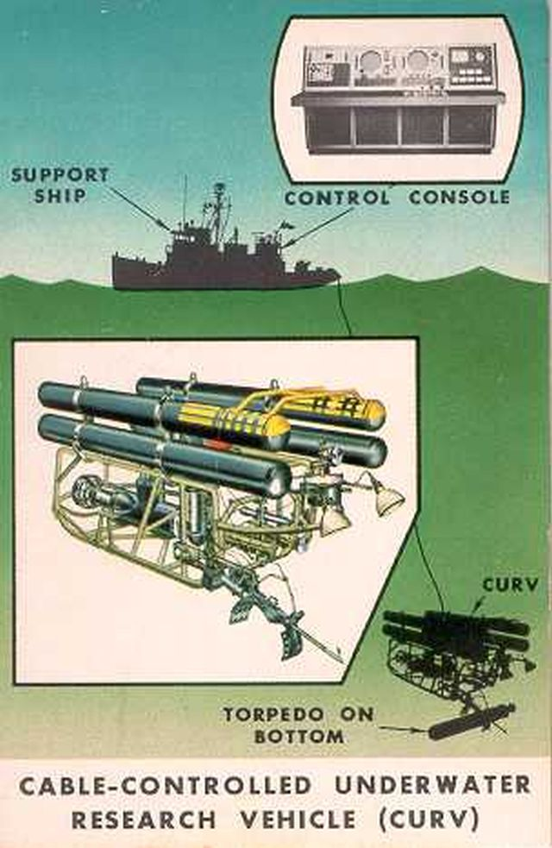
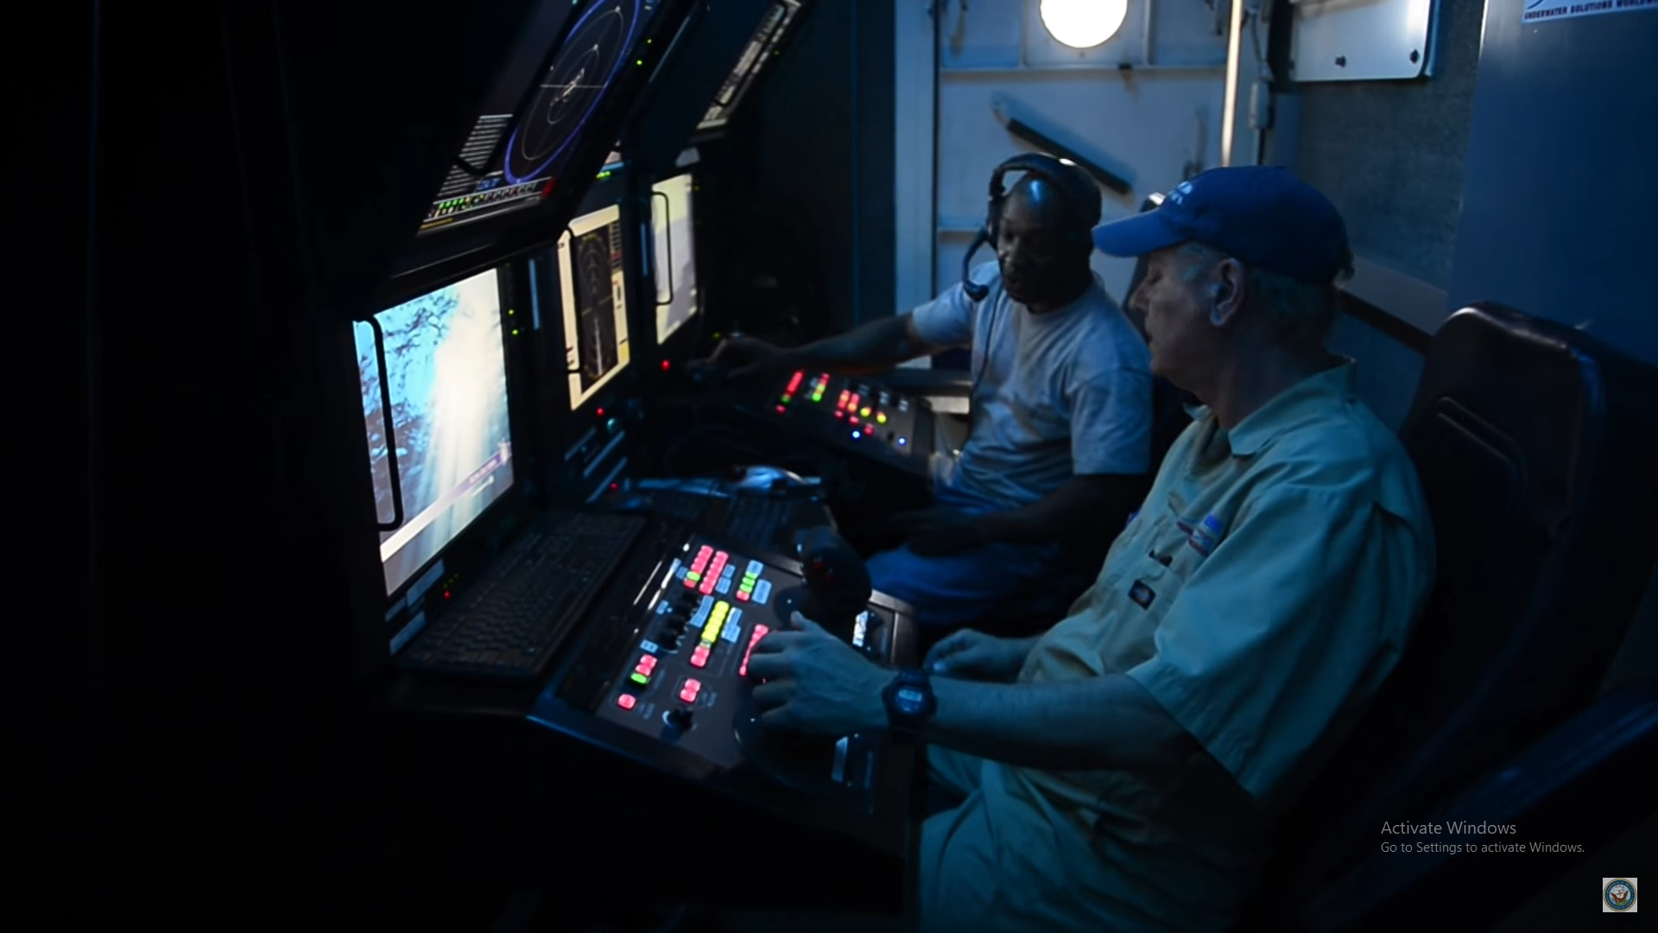
iii. Navigation System & Control
CURV I & CURV II | CURV III
On the surface, a five-man team is in charge. This team leads, controls, and monitors the recovery operation using a closed-circuit television network and acoustic detection and location components. | Employs technologies developed for the Remote Unmanned Work System (RUWS) and Advanced Tethered Vehicle (ATV).

Slide 19
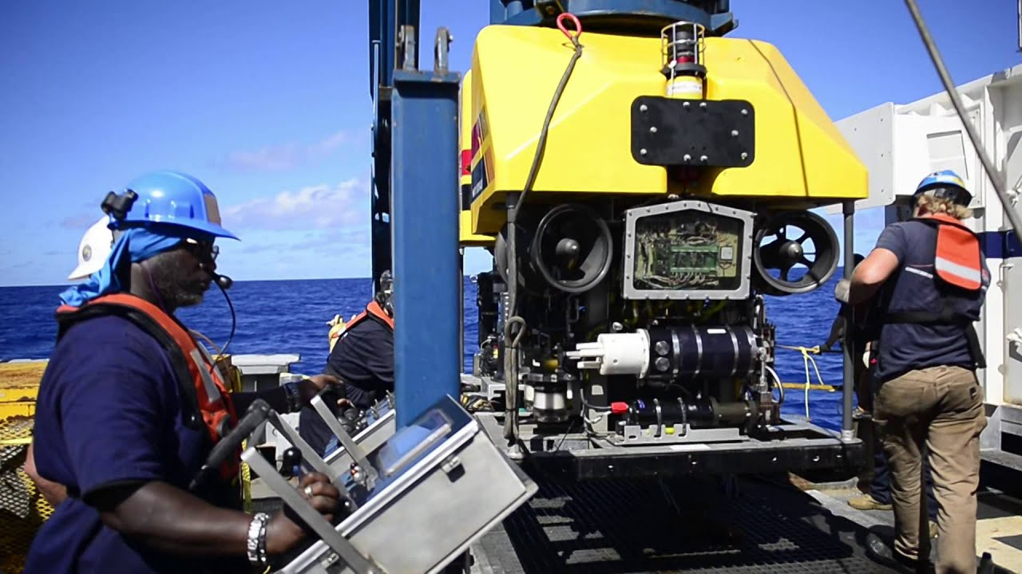
iii. Navigation System & Control
CURV 21
The ORION (towed side scan-sonar) and CURV-21 can be coupled to form a single integrated search and recovery system that can be deployed on a USNS T-ATF. The system is built around a 0.680 fiber-optic umbilical cable and a shared handling system, which can switch between side-scan sonar and ROV operations while at sea.

Slide 20
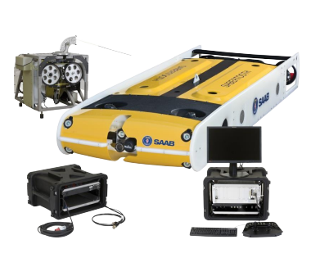
iii. Navigation System & Control
The surface equipment for the Sabertooth includes a surface control unit comprising a computer with the graphical interface software displayed on a monitor.
Additional operator equipment includes a keyboard and mouse.
A WLAN Access Point with an antenna is used when the vehicle is in autonomous mode.
An automated tension control winch is used in conjunction with a tether when working in manual mode.
The operator's monitor controls the vehicle's GUI, diagnostics, mission plans, and displays data and video via Fibre Optic or WLAN.
Saab Seaeye Sabertooth

Slide 21
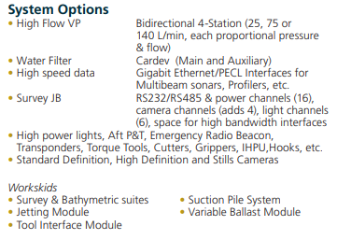
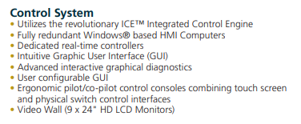
iii. Navigation System & Control
Perry XLX EVO
Control System: ICE™ Real Time Control System with GHz Optical Link, Ethernet Telemetry and Graphical Diagnostics
Control Modes: Heading, Depth, Altitude, Park & Dynamic Positioning

Slide 22
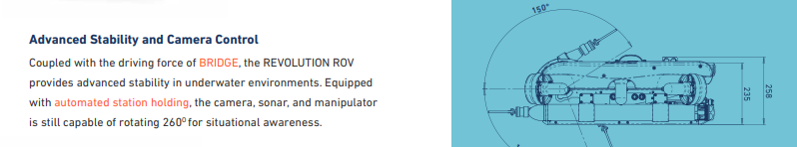
iii. Navigation System & Control
The surface equipment for the Sabertooth includes a surface control unit comprising a computer with the graphical interface software displayed on a monitor.
Additional operator equipment includes a keyboard and mouse.
A WLAN Access Point with an antenna is used when the vehicle is in autonomous mode.
An automated tension control winch is used in conjunction with a tether when working in manual mode.
The operator's monitor controls the vehicle's GUI, diagnostics, mission plans, and displays data and video via Fibre Optic or WLAN.
Deep Trekker Revolution

Slide 23

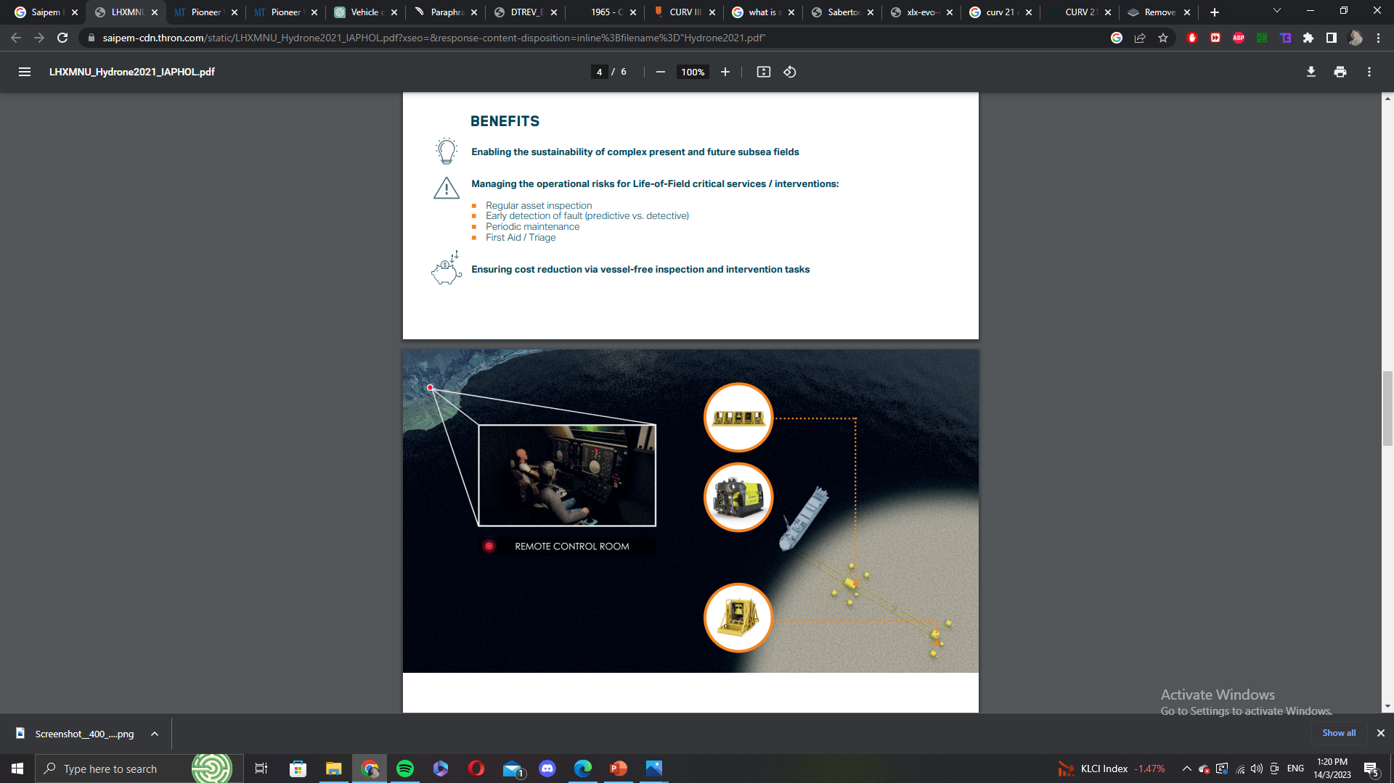
iii. Navigation System & Control
Saipem's Hydrone-R

Slide 24
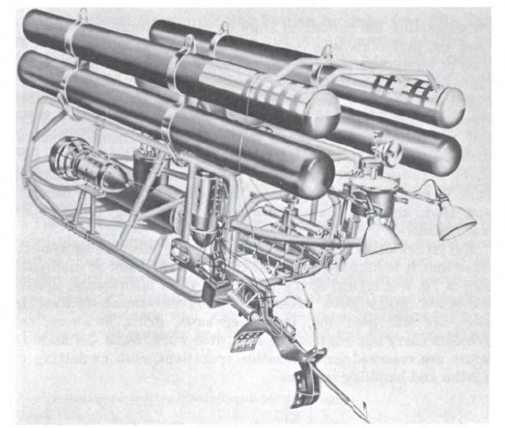
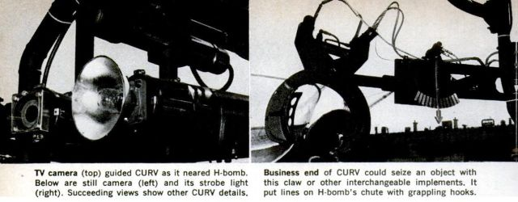
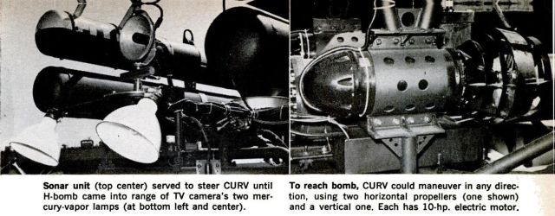
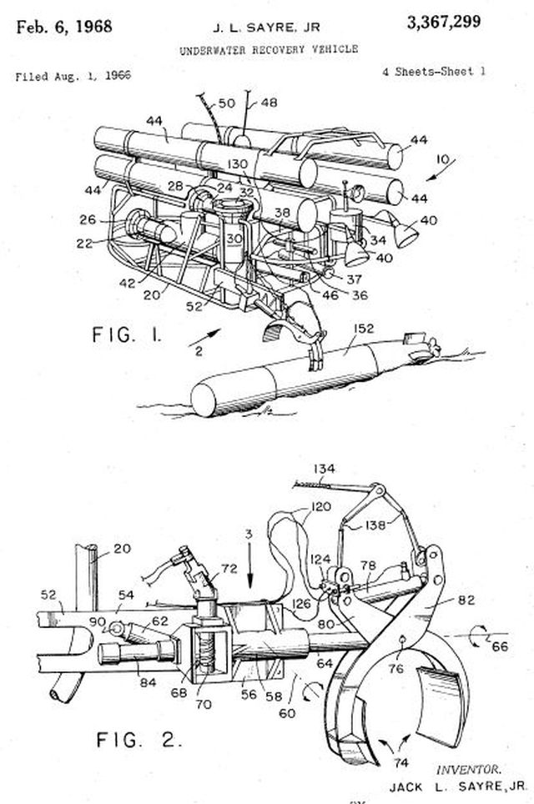
iv. Data Collection (Payload)
CURV I
Sonar
TV Camera
Gripper

Slide 25
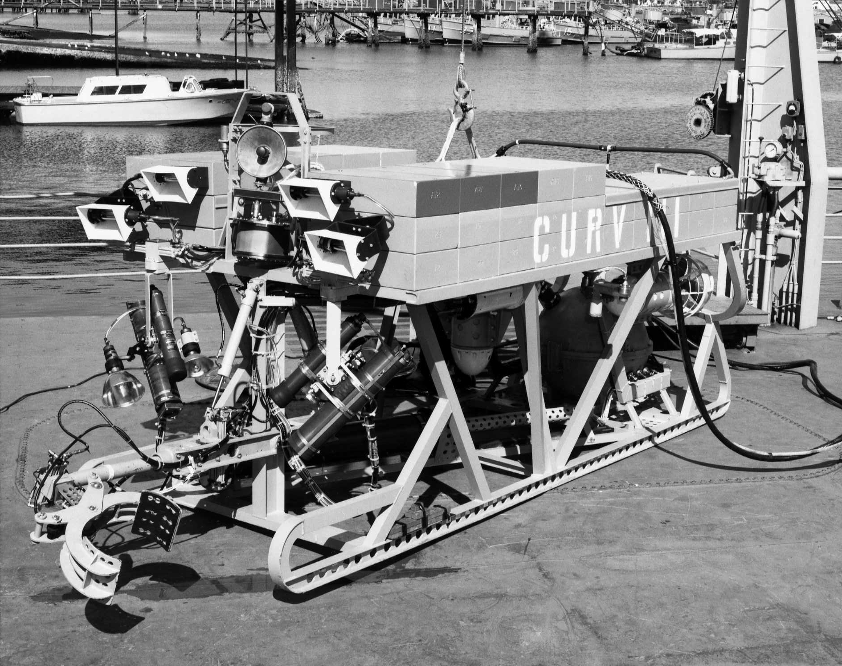
iv. Data Collection (Payload)
CURV II
Sonar
Gripper
Gripper
CURV III
TV Camera

Slide 26
iv. Data Collection (Payload)
CURV 21
Seven function rate manipulators
High resolution digital still camera
Black and white, and color television cameras
CTFM sonar

Slide 27
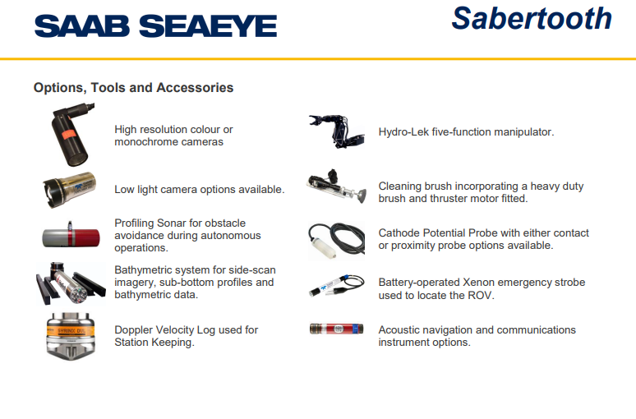
iv. Data Collection (Payload)
Saab Seaeye Sabertooth

Slide 28
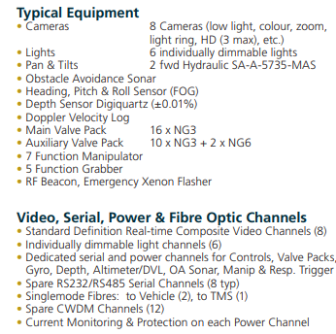
iv. Data Collection (Payload)
Perry XLX EVO

Slide 29
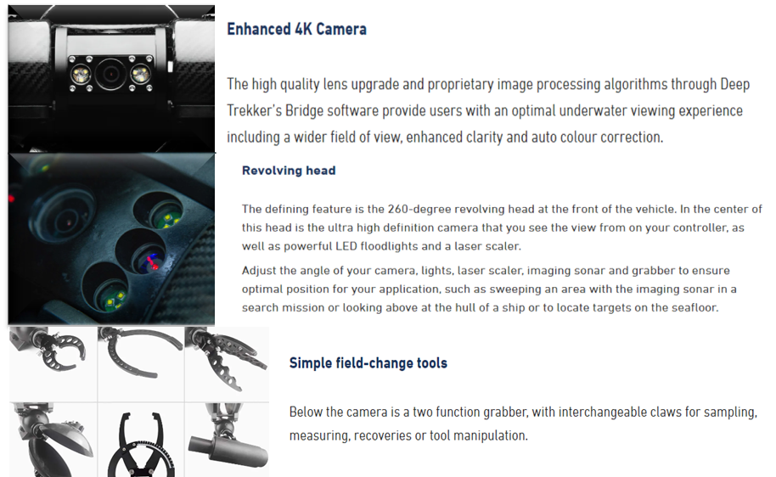
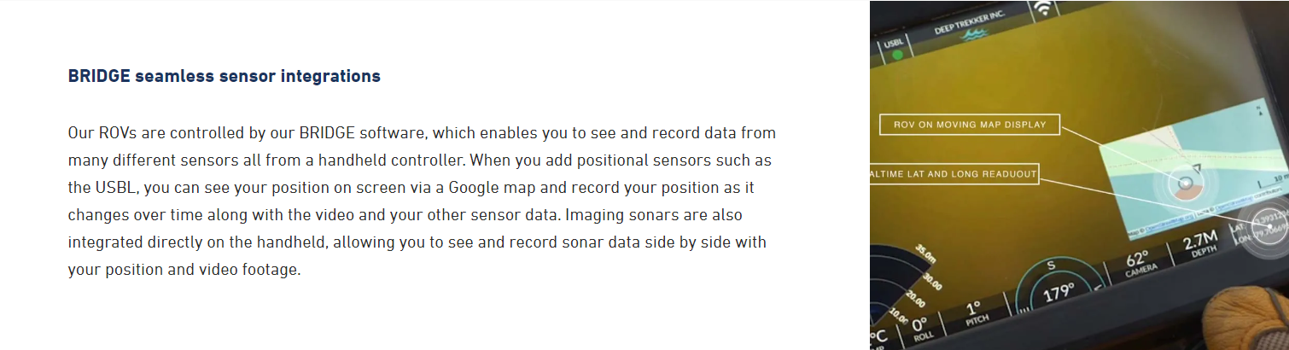
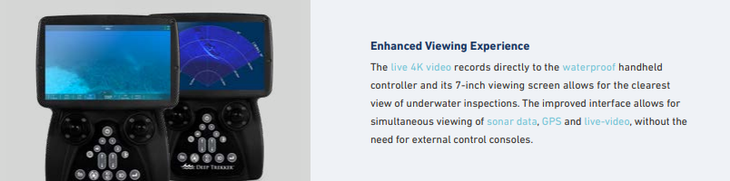
iv. Data Collection (Payload)
Deep Trekker Revolution

Slide 30
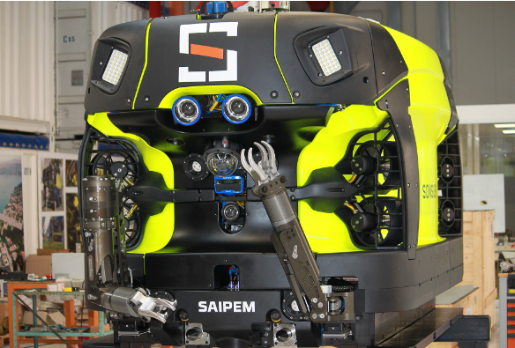
iv. Data Collection (Payload)
Saipem's Hydrone-R
Sensors
Manipulator arms
Camera

Slide 31
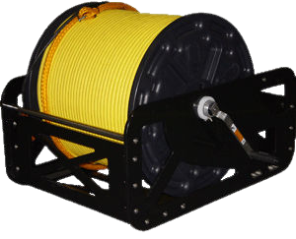
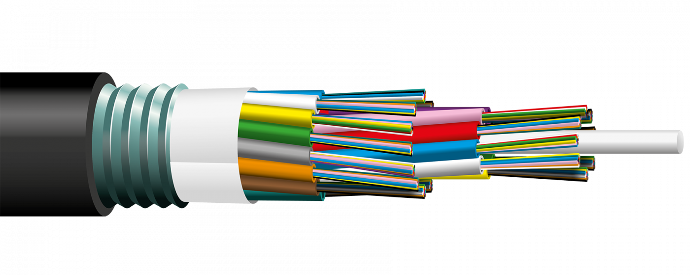
v. Data Transmission (Communication)
CURV-I ROV communicates with the surface vessel through an umbilical cable.
The umbilical cable connects the ROV to power and communication.
A fibre optic cable is commonly utilized as the communication system, allowing for high-speed data transfer and real-time control of the ROV's motions and sensors.
The surface control system consists of a computer workstation and control panel that allow the operator to view and manage the ROV's video and sensor feeds as well as its movements and operations.
CURV I
Umbilical cable
Fibre optic

Slide 32
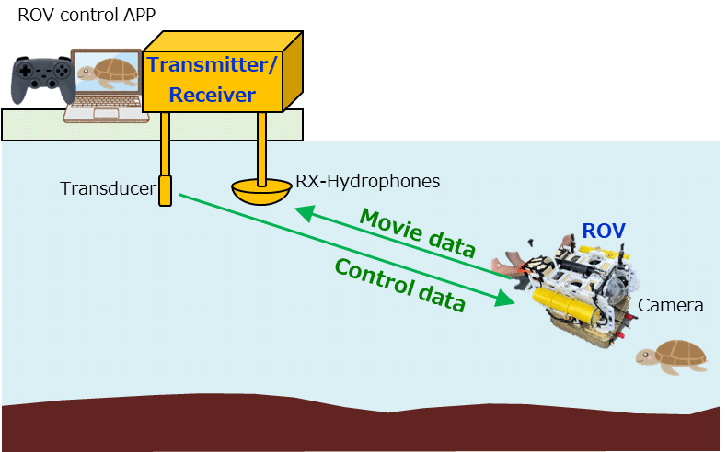
v. Data Transmission (Communication)
Curv II ROV has a fibre optic communication system for fast data delivery.
Enables real-time video and data transmission from the ROV to the surface.
Allows the surface control station to control the ROV remotely.
Curv II can be outfitted with acoustic communication devices enabling longer-distance communication in low-light settings.
The acoustic system transmits data and commands between the ROV and the surface control station using sound waves.
The Curv II can also be outfitted with a wireless communication system that allows the ROV to communicate with other underwater equipment or devices.
CURV II
Acoustic communication system

Slide 33
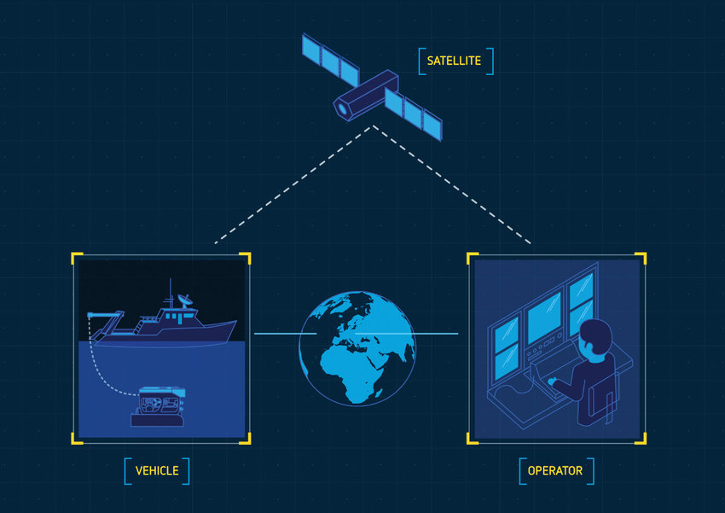
v. Data Transmission (Communication)
Tether Communication: The tether is the primary route of communication between the ROV and the surface control unit. The cable powers the ROV and transfers data and video feeds from the ROV to the surface, and allows the surface operator to control the its movements and functions
Acoustic Communication: The ROV is outfitted with an acoustic modem that allows it to communicate with other underwater vehicles or systems, as well as acoustic locating devices.
Satellite Communication: The ROV can be outfitted with a satellite modem to allow connection with the surface control unit from remote areas such as deep-sea deployments or offshore oil rigs.
CURV III
Satellite communication

Slide 34
v. Data Transmission (Communication)
The system is built around a 0.680 fiber-optic umbilical cable and a shared handling mechanism that allows the system to switch between side-scan sonar and ROV operations while at sea.
The fibre optic multiplex system can integrate up to eight channels of video, sonar, USBL, RS-232/422/485 data communications, and navigation data on a single cable.
The vehicle is controlled by a digital communications network with a data capacity of 400 MHz and ample room for future growth.
CURV 21

Slide 35
v. Data Transmission (Communication)
Saab Seaeye Sabertooth
WLAN Access Point
Fibre Optic receiver and tether for manual mode

Slide 36
v. Data Transmission (Communication)
Both fibre optic and copper umbilicals can be used to communicate with the Perry XLX EVO ROV.
The copper umbilical offers power and low-bandwidth data connection, whereas the fibre optic umbilical provides high-bandwidth communication for video and data transfer.
For short-range communication, the ROV can also be outfitted with a wireless communication system.
A graphical user interface (GUI) on a computer or a joystick controller can be used to operate the control system.
Perry XLX EVO

Slide 37
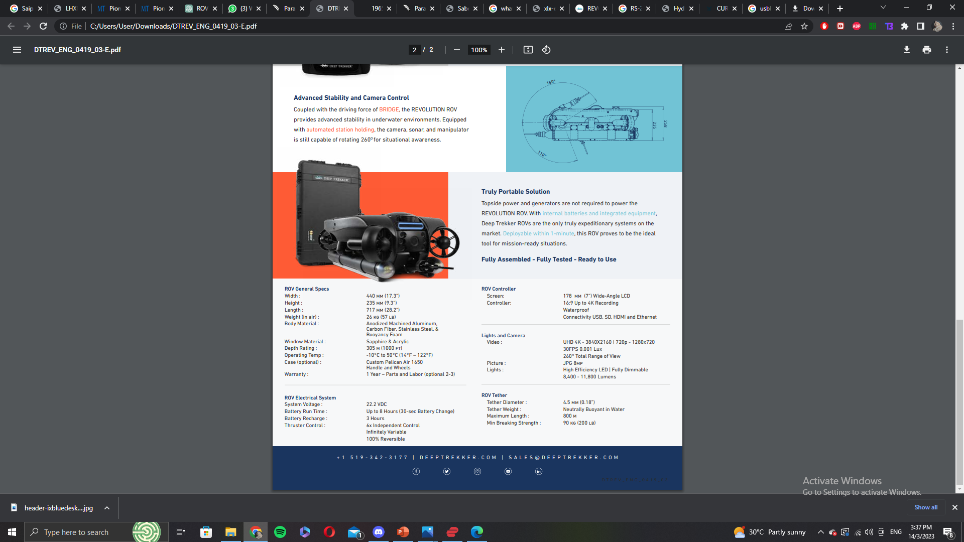
v. Data Transmission (Communication)
Deep Trekker Revolution ROV communicates with the topside controller and the vehicle via a wireless communication system.
The system uses a secure frequency-hopping spread spectrum signal to transmit video and control the ROV in real time.
The topside controller includes a laptop computer and a joystick controller, allowing the operator to control the movement, camera, and other aspects of the ROV.
In optimal conditions, the system's wireless range can reach up to 300 metres (984 ft).
A Wi-Fi hotspot feature is also included in the system, allowing several people to connect to and manage the ROV using their mobile devices.
Deep Trekker Revolution

Slide 38
v. Data Transmission (Communication)
Saipem Hydrone-R ROV communicates via a fibre optic connection, which offers both high-speed data transfer and electricity for the vehicle's activities.
It also contains a wireless connection system that allows for remote vehicle control and monitoring, as well as video and data transmission.
The wireless communication system works by sending acoustic signals through the water to a surface buoy, which relays the signals to an onshore control centre.
Saipem's Hydrone-R

Slide 39

vi. Power Management
CURV 21

Slide 40
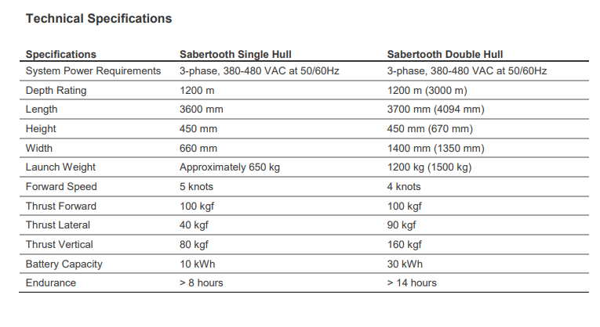
vi. Power Management
Saab Seaeye Sabertooth
At the surface, a battery charger placed in a mobile case can recharge the vehicle.
The unit has a charging power of 3.3 kW (reduced power when the input voltage is less than 200 VAC) and an input power range of 100-264 VAC (single phase).

Slide 41
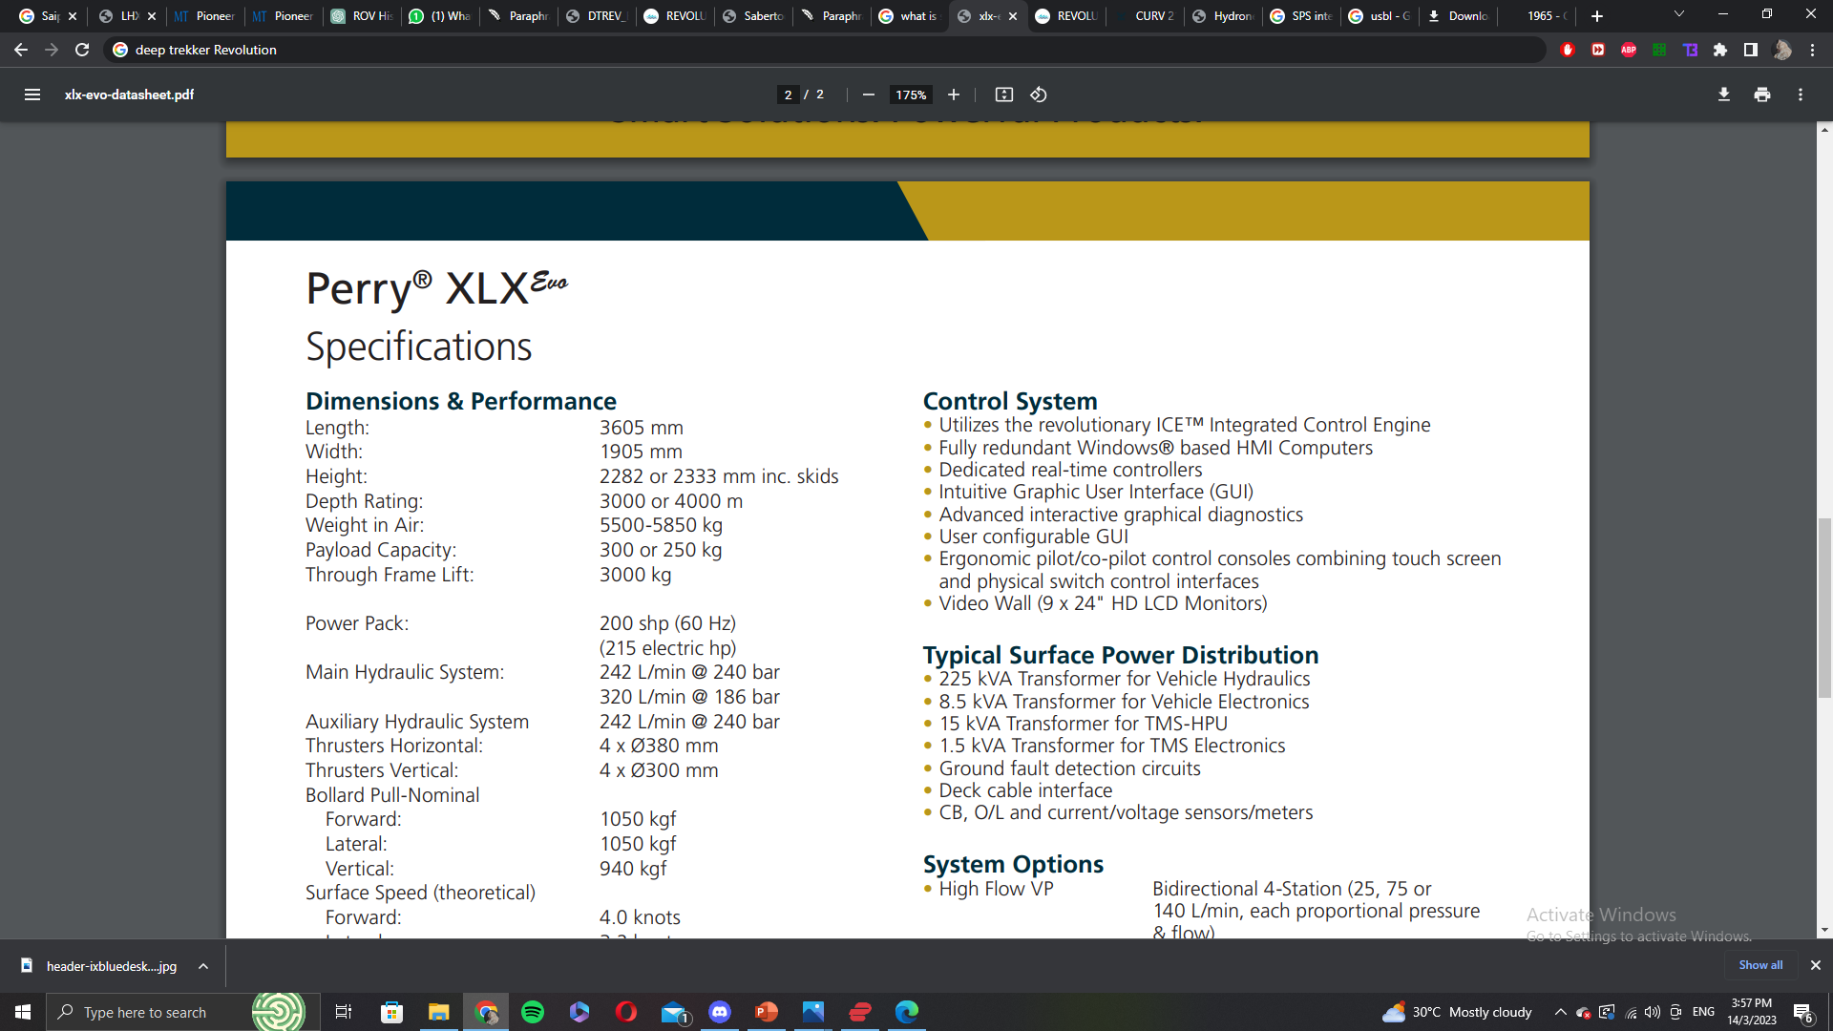
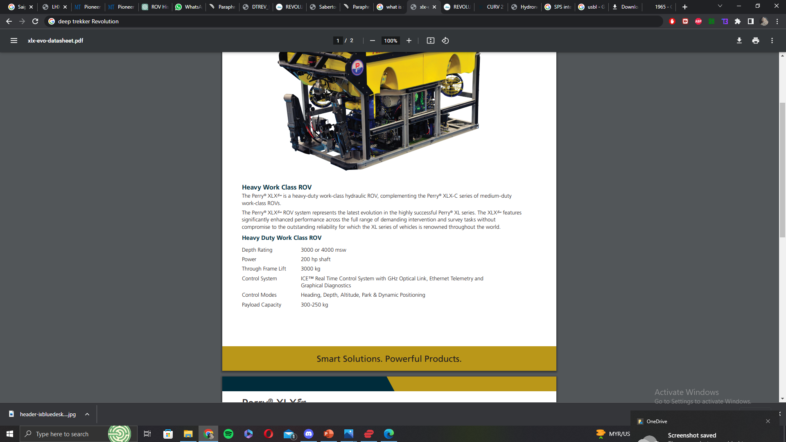
vi. Power Management
Perry XLX EVO

Slide 42
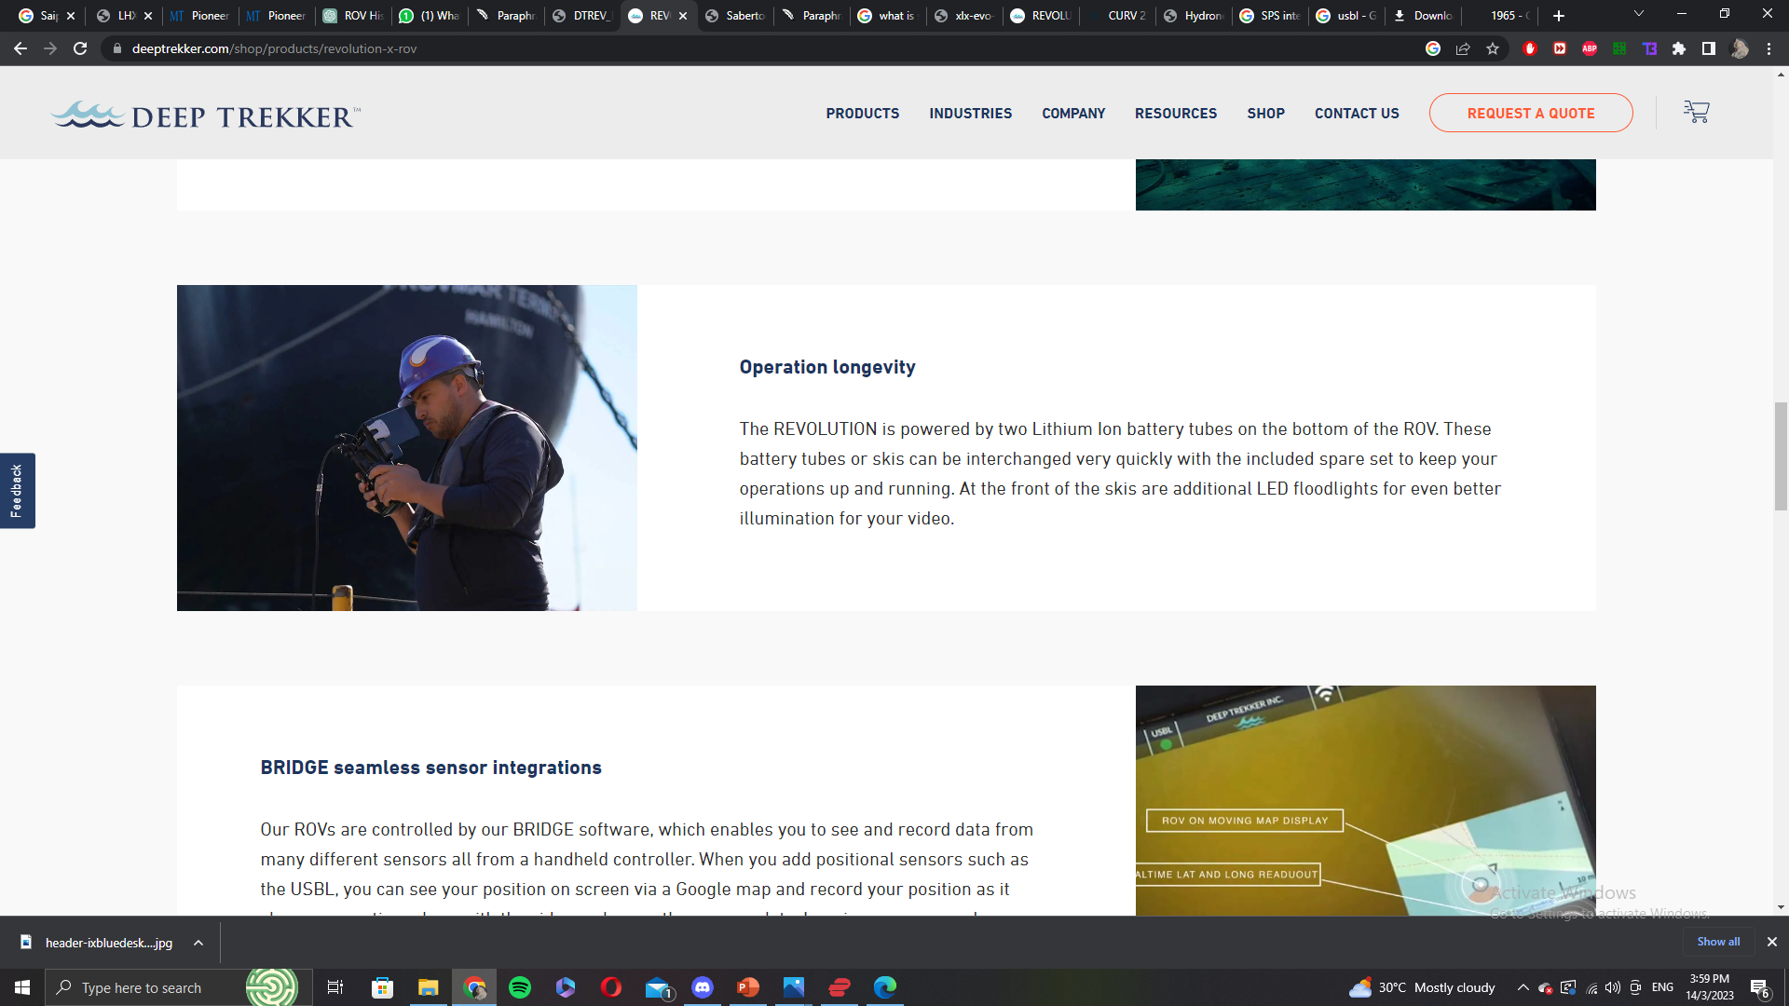
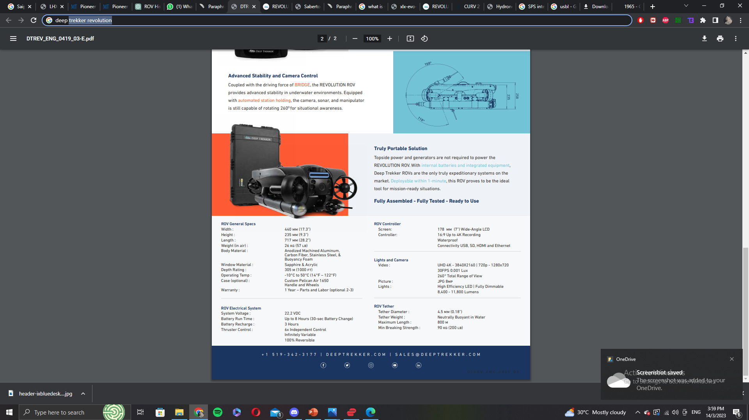
vi. Power Management
Deep Trekker Revolution

Slide 43

vi. Power Management
Saipem's Hydrone-R

Slide 44


